Slide 1

Cigarette Data Analysis
From 1985-1995

Slide 2
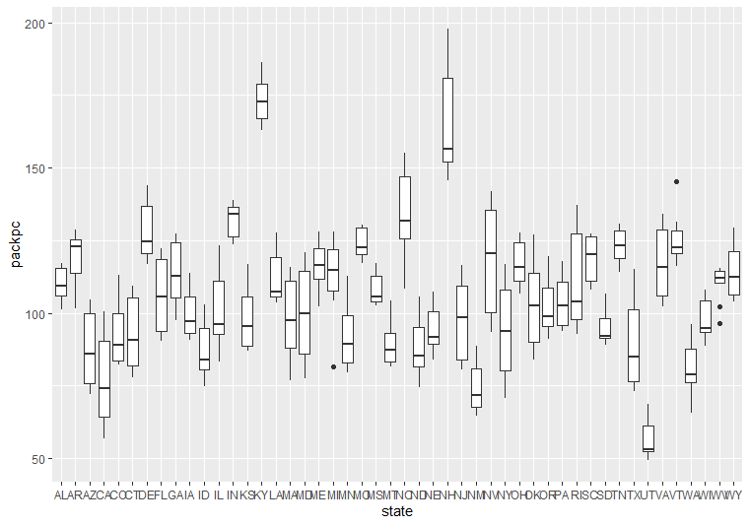
1. Create a boxplot of the average number of packs per capita by state.

Slide 3



2. Which states have the highest number of packs? Which have the lowest?
The highest number of packs per capita is KY
The lowest number of packs per capita is UT
1. ggplot(Cigarette, aes(x = state, y = packpc)) + geom_boxplot()
2. Cigarette %>% group_by(state)%>% summarise (Mean = mean(packpc)) %>% arrange(desc(Mean))

Slide 4
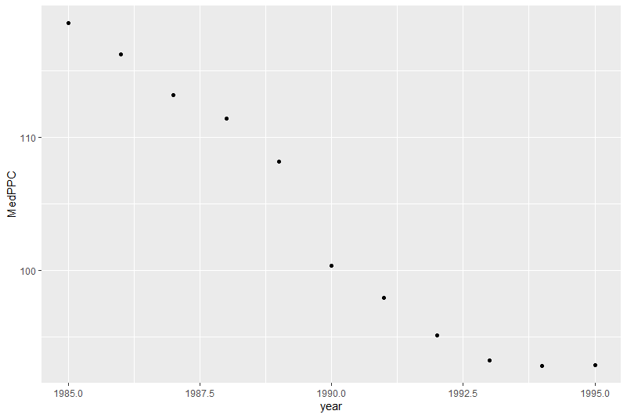
3. Find the median over all the states of the number of packs per capita for each year. Plot this median value for the years from 1985 to 1995.
Code:
MedianPPC = Cigarette %>% select(packpc, state, year) %>% group_by(year) %>% summarise(MedPPC = median (packpc))
ggplot(MedianPPC, aes(x = year, y = MedPPC)) + geom_point()

Slide 5

4. What can you say about cigarette usage in these years?
You can tell by this chart that in the decade from 1985 to 1995 the median packs per capita declined significantly.

Slide 6
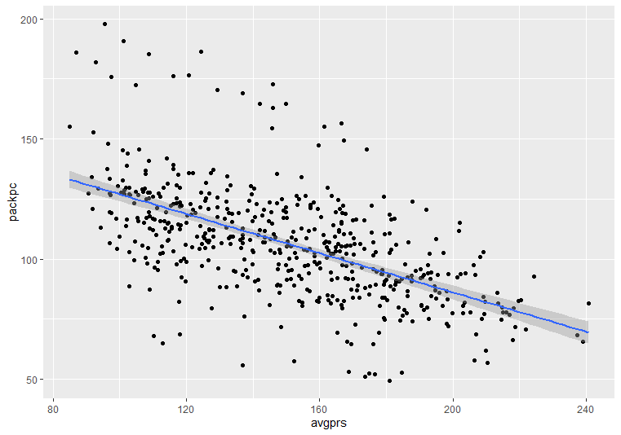
5. Create a scatter plot of price per pack vs number of packs per capita for all states and years.

Slide 7
6. Are the price and the per capita packs positively correlated, negatively correlated, or uncorrelated? Explain why your answer would be expected.
You can observe a negative correlation in the plotted data. As the average price increases, the pack per capita decreases.
This answer is to be expected, because as a product becomes more expensive it makes sense that less people would be able to access it.
Code: ggplot(Cigarette, aes(x = avgprs, y = packpc)) + geom_point() + geom_smooth(method=lm)

Slide 8
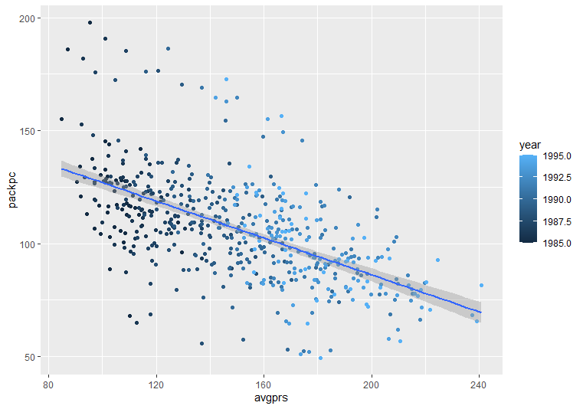
7. Does the relationship between the two variables change over time?
You can observe in the graphed data that throughout the decade there has always been a consistent negative correlation between pack per capita and average price.
Code: ggplot(Cigarette, aes(x = avgprs, y = packpc, color = year)) + geom_point() + geom_smooth(method=lm)

Slide 9
8. Do a linear regression for these two variables. How much variability does the line explain?
Coefficients:
Estimate Std. Error t value Pr(>|t|)
avgprs -0.40879 0.02468 -16.56 <2e-16 ***
---
Signif. codes: 0 ‘***’ 0.001 ‘**’ 0.01 ‘*’ 0.05 ‘.’ 0.1 ‘ ’ 1
Residual standard error: 18.76 on 526 degrees of freedom
Multiple R-squared: 0.3427, Adjusted R-squared: 0.3415
F-statistic: 274.3 on 1 and 526 DF, p-value: < 2.2e-16
(Intercept) 167.87737 3.79749 44.21 <2e-16 ***
Adjusted R-squared: 0.3415
34% of the variability
Code: regression = lm(packpc~avgprs, Cigarette) summary(regression)

Slide 10
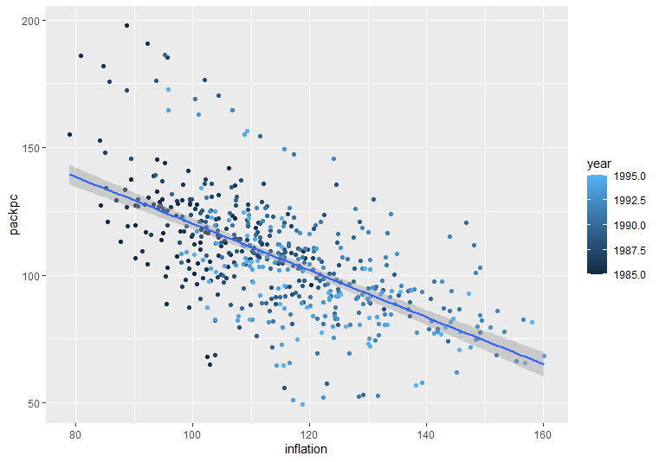
9. You can adjust the price of a pack of cigarettes for inflation by dividing the avgprs variable by the cpi variable. Create an adjusted price for each row, then re-do your scatter plot and linear regression using this adjusted price.
Coefficients:
Estimate Std. Error t value Pr(>|t|)
(Intercept) 211.76821 5.95792 35.54 <2e-16 ***
inflation -0.91640 0.05138 -17.84 <2e-16 ***
---
Signif. codes: 0 ‘***’ 0.001 ‘**’ 0.01 ‘*’ 0.05 ‘.’ 0.1 ‘ ’ 1
Residual standard error: 18.27 on 526 degrees of freedom
Multiple R-squared: 0.3769, Adjusted R-squared: 0.3757
F-statistic: 318.1 on 1 and 526 DF, p-value: < 2.2e-16
Adjusted R-squared: 0.3757
38% of the variability
Inflate = Cigarette %>% mutate(inflation = avgprs/cpi)
ggplot(Inlfate, aes(x = inflation, y = packpc, color = year)) + geom_point() + geom_smooth(method=lm)

Slide 11
10. Use a paired t-test to see if the number of packs per capita in 1995 was significantly different than the number of packs per capita in 1985.
Paired t-test
data: Cigs85$packpc and Cigs95$packpc
t = 14.789, df = 47, p-value < 2.2e-16
alternative hypothesis: true difference in means is not equal to 0
95 percent confidence interval:
22.21151 29.20576
sample estimates:
mean of the differences
25.70863
P value is < .05 There is a significant difference in the packs per capita of 1985 and 1995.
1. Cigs85 = Cigarette %>% filter(year== 1985) Cigs95 = Cigarette %>% filter(year== 1995)
2. t.test(Cigs85$packpc,Cigs95$packpc, paired=TRUE)

Slide 12
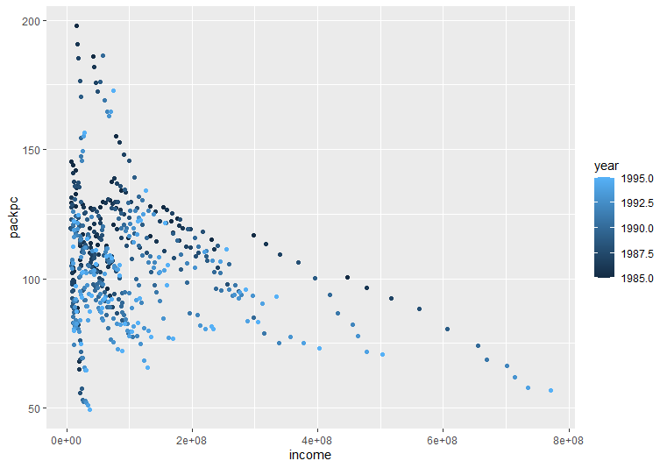
11. In the process of doing this project, have any questions come to mind that this data set could answer? If so, pick one and do the analysis to find the answer to your question.
How does income compare to pack per capita?
From an initial glance at the graphed date it looks as though it may be that higher incomes result in lower pack per capita.
ggplot(Cigarette, aes(x = income, y = packpc, color = year)) + geom_point()

